Slide 1
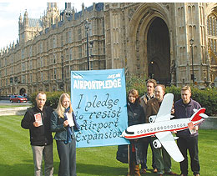

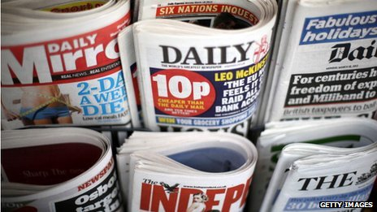
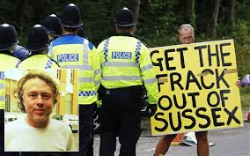
Pressure Groups and The Media

Slide 2
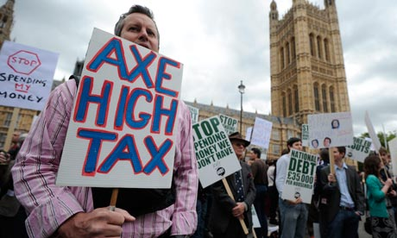
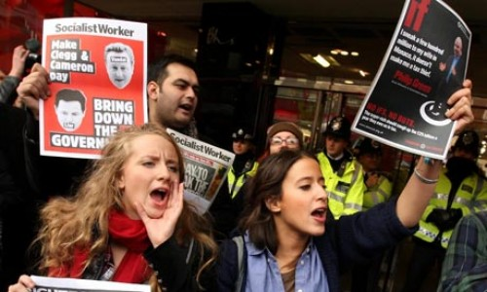
Pressure Groups
Areas we will focus on
Types of PGs
How Pressure groups influencing decision making
Are they good or bad for democracy?

Slide 3
Pressure groups
A pressure group (PG) can be described as an organised group that is set up to influence governmental policy and decisions without seeking to win political power.
PGs offer the public an alternative means of putting forward their points of view in addition to voting in elections.
In Britain, the number of political parties is on the small scale compared to the mass number of pressure groups that run into their thousands.
Pressure Groups can be distinguished in a variety of different ways including; local/national/European/transnational groups and temporary/permanent groups, however the most common way is cause and sectional, insider and outsider (more on this later)

Slide 4
The rise of Pressure Groups
Less people nowadays join political parties
More people are members of pressure Groups
A Report The POWER INQUIRY published in March, 2006 claims that people are just as interested in politics as they were in the past
BUT
They feel disengaged with conventional politics in the form of parties and elections
They believe more in direct action through Pressure groups
Pressure groups have engaged more young people
Can you think of single issues which caused young people to participate in politics and try and influence decision making?
Notes:
4

Slide 5


Different types of Pressure Groups
There are many different types of pressure groups.
PGs can be large international organisations such as:
Greenpeace or Friends of the Earth which campaign on environmental issues. This impacts the whole world therefore people from other countries will want to get involved.
Or very small local groups e.g. stop school closures in North Lanarkshire
They can be short term organisations which last until the campaign is over and a decision is made .i.e. gay marriage or school closures
Or they can be almost permanent organisations like Greenpeace, or CND. This is because there cause is ongoing.

Slide 6
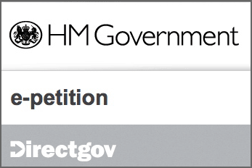
Pressure Group methods
Pressure groups will use different methods to try and get public support or to influence the government. They could:
Protest/demonstrate
Organisation a petition
Boycott
Use social media
Website
Poster/leaflet/letter campaigns
Get a celebrity member
Get political support – MSP/MP member
Pay a professional lobbyist
Sometimes these legal methods are not enough and some Pressure groups will break the law. This can be risky, as you risk losing public support

Slide 7
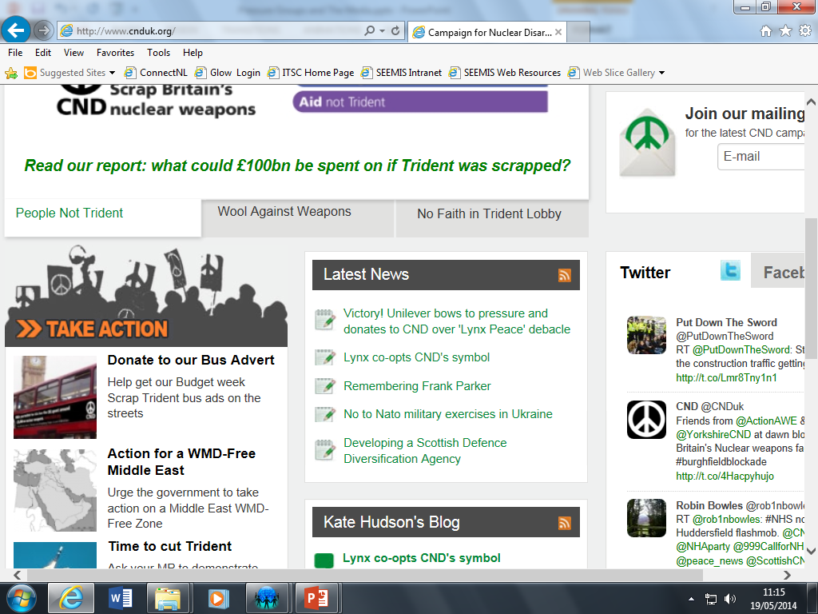
Pressure Group examples
CND are an international pressure group who campaign against the use of nuclear weapons
The Nuclear Weapons base is in Scotland. The weapons are kept on the River Clyde at Coulport near Faslane.
Some people have dedicated their life to protesting outside the nuclear base.
CND members want the UK to get rid of nuclear weapons and leave NATO.

Slide 8
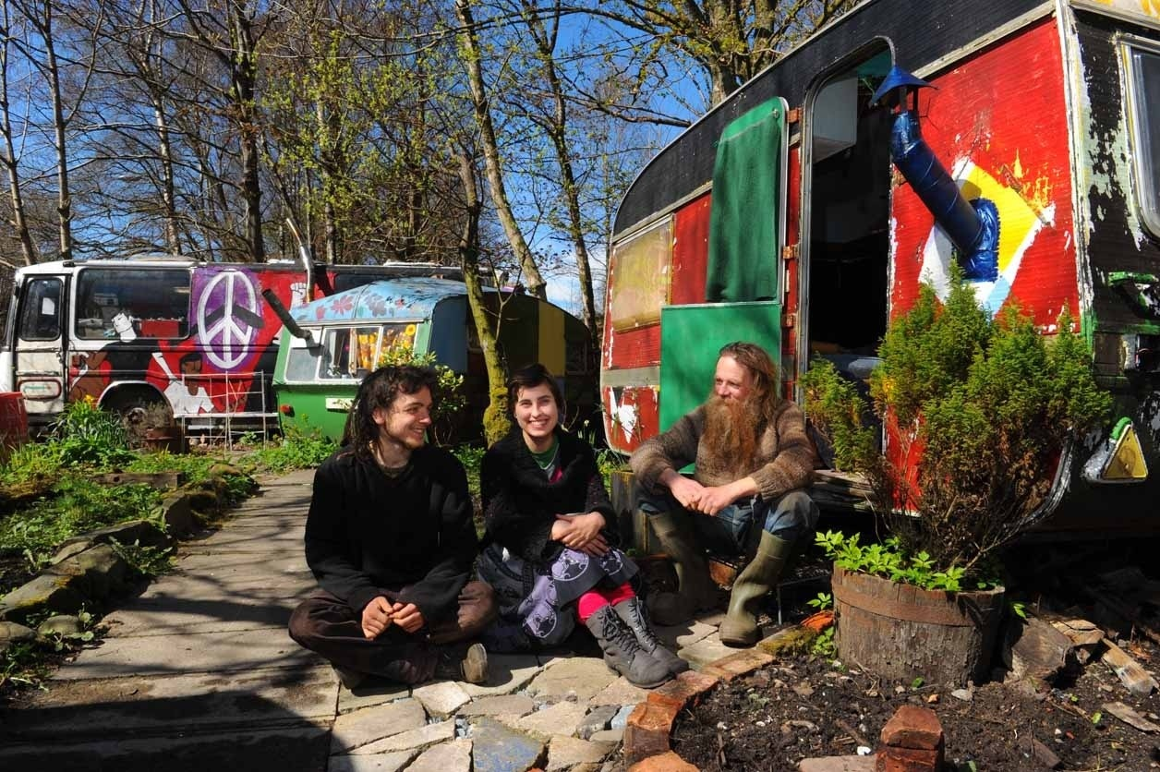
The CND camp is the last remaining legal camp in the UK
The camp now only has 4 people remaining
It looks set to be replaced by a peace garden – this takes away from the idea of action as no protesters will be on the site.
Does this indicate that people might care about a cause but are less likely to suffer in order to promote it
CND did have high profile political members who have now been shamed i.e. Tommy Sheridan and George Galloway

Slide 9

Success for CND
The CND peace symbol has recently been used by Lynx deodorant to launch their new brand.
The symbol was designed by a member of CND and deliberately not copy righted so it would spread as a universal symbol.
Lynx using this to market a brand goes against this ideal.
Millions of people took to Facebook and Twitter to criticise the private company for exploiting CNDs symbol
Lynx has now agreed to pay money to CND for the use of this symbol
Does this indicate that new forms of participation using technology is more successful than traditional forms of protest like the camp?

Slide 10
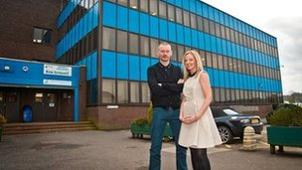
Save Abronhill High Campaign
Locals in Cumbernauld fought against the council decision to close Abronhill High.
Parents and pupils held public meetings with representatives
They organised a petition
They set up Twitter and Facebook accounts
They got the stars from Gregory’s Girl to help gain them media attention (a cult film from the 80s was filmed at the school)
They protested
Yet the decision was too still close the school
This may be why some groups turn to illegal methods
Clare Grogan and John Gordon Sinclair outside the school they filmed Gregory's Girl

Slide 11

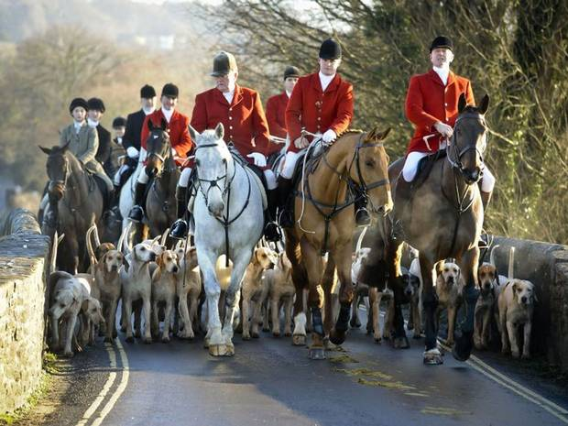
Badger Culling in the UK
It was proposed in 2011 that there should be a badger cull (organised killing) because the rate of TB in cattle was rising and many farmers blamed badgers.
The Countryside Alliance is a pressure group who represent the interest of people in rural areas across the UK.
They are a powerful organisation who have a lot of middle class members (these people tend to vote), normally Tory voters.
This group wanted the cull to go ahead and actually wanted farmers to have the right to kill badgers on their own via shooting and traps.

Slide 12
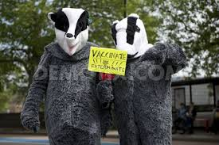
On the other hand groups like the RSPCA and The Badger Trust group both condemned the Badger cull.
They felt it was inhumane to kill animals in this way
They felt it would not work as injections would be more effective
They got Brian May (member of Queen – rock band from 80s – We will rock you) to front their campaign
Brian May went on numerous news programmes and chat shows to front the anti-cull movement
There was a badger video which got thousands of hits on YouTube and became a YouTube sensation.

Slide 13
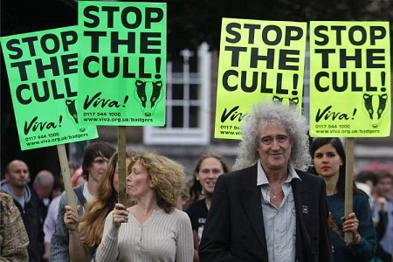
However the UK government did decide to pilot this scheme in some areas in England
Success has not been great and the reduction in badger numbers has been less than expected
A similar idea is being put forward to cut the numbers of deer's in Scotland
Again there will be a clash of opinion from those who live and work in rural Scotland compared to animal rights activists
The Countryside Alliance have come out and publically slagged the RSPCA and told members not to give this organisation any funds!!
Brian May – do you remember him now?

Slide 14

Extreme Pressure Group – Animal Liberation Front (ALF)
The Animal Liberation Front (ALF) is an international, underground leaderless movement that engages in illegal direct action to stop cruelty to animals.
Activists will go to extreme lengths to remove animals from laboratories and farms, destroying facilities, arranging safe houses and veterinary care, and operating sanctuaries where the animals subsequently live.
Critics have compared them to terrorists because they use such violent methods at time.

Slide 15
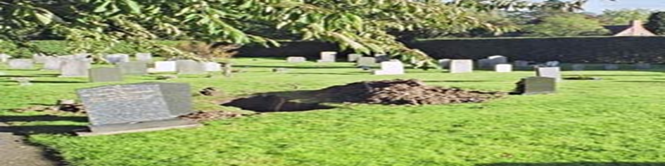
In 2006 three ALF members were arrested for stealing the body of a guinea pig farmers mother.
The Hall family who own a guinea pig farm in Staffordshire were the target of a hate campaign by animal right activists. There farm was targeted by protesters who would vandalise and break into the farm. Staff were threatened
It got so bad that the family grave was dug up and the corpse of the families late mother was taken ransom. The owner was then sent a letter telling them the body would be returned to the grave when the farm was shut down.
The farm effectively stopped breeding for medical research
The activists informed the police were the body was hidden and it was returned to the grave
Three animal rights activists were charged for the crime and sent to prison
This is very extreme behaviour and lost the pressure group pupil support
Can the group consider their actions as successful?

Slide 16

Types of Pressure Groups
Insider/Outsider Groups
Insider groups have privileged access to government Ministers and Civil Servants
They can influence policies in secret
EG the Government wish to reform the NHS in some way
The British Medical Association (BMA) are invited to comment and suggest how policy should be changed
Other groups do not have this privilege and are OUTSIDE the decision making process
Notes:
16

Slide 17
Insider Groups Jamie Oliver newsnight
Insider pressure groups are given this special privilege because their members often have expertise the government need for example the British Medical Association represents doctors and surgeons therefore if the government want to change something in the NHS they need this groups support
Insider group can often provide evidence in support of government policy. This helps ministers if they need to give evidence to committees
Insider groups will however be expected to act in an appropriate manner and never break the law

Slide 18
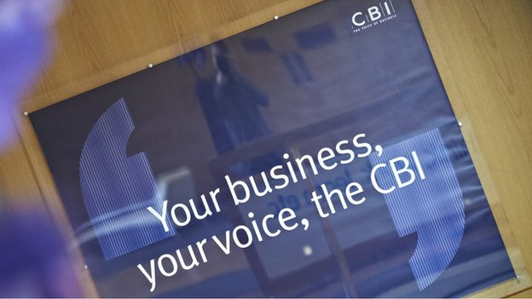
Insider status can change depending on which party is in government
For example the Countryside Alliance were very much outsider when the Labour government wanted to ban fox hunting. This meant they had to protest and at times use extreme methods.
Now the Tory party have regained power this group are much more likely to be listened to as many members of this group will vote Tory. The badger cull is an example of this shift in power.
Likewise the Scottish Government will be more likely to ask for advice from Business for Scotland than CBI. CBI came out and backed the Better Together Campaign before retracting their position because they are suppose to be neutral.
On the other hand CBI are still very influential and hold insider status with the UK government.

Slide 19
Trade Unions
Trade Unions USE to be insider groups until the 1970s and Thatcherism.
A newspaper at the time of Margaret Thatcher shunning the TU made a famous quote “there will be no more sandwiches and beer at number 10” –
This showed that TU had lost their insider status and where now outsider
Trade unions use to have a close relationship with the Labour party and still sometimes pay money to the party. This relationship changed with New Labour and they do not hold the same influence.

Slide 20
Outside Groups
These groups are outside the political process
They do not have direct contact with government Ministers
They prefer it this way as it means they can publicise their cause through the media
Examples are CND, Greenpeace, the Anti War Coalition
They can hire professional lobbyists to speak to Ministers
This is called Indirect Lobbying/action
Direct Lobbying is speaking directly to MPs who can then speak on the group’s behalf i.e. John McDonnell (MP Haynes and Harlington) helping the opposition to Heathrow’s 3rd run way.

Slide 21
Ways of Applying Pressure
1. MPs/Parliament
2. Ministers
3. Prime Minister
4. Civil Service
5. Media
6. Finance
7. Celebrities
Remember outsider pressure groups need to rely on media attention and public support and membership in order to gain influence.
This means they have to be careful about balancing getting attention with keeping the public on side.
Notes:
21

Slide 22
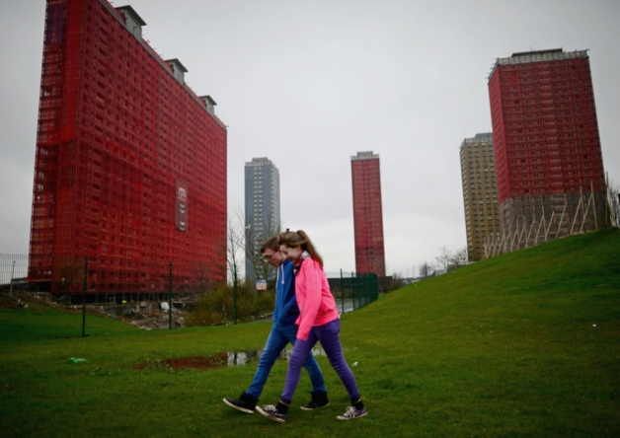
Commonwealth Games Opening Ceremony
Opposition to blowing up the Red Road Flats
Glasgow City Council wanted to blow up the Red Road flats as part of the opening Ceremony
Over 4000 people signed an e-petition to stop this because they felt that this was disrespectful to residents of that area
Many newspapers ran with the story and celebrities like Greg Hemphill (Still Game) signed the petition
Organisers backed down
This is an example of people power staying within the law

Slide 23
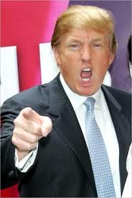
Tripping up Trump
This group was set up after Donald Trump (American businessman) bought land to build a new golf course
This land was a site of scientific interest because of a sand dune system
Local residents were also threatened with compulsory purchase orders (CPO) for their homes.
The pressure group was set up to fight against these CPO.
This pressure group were up against Aberdeen council and the Scottish Government who seen the financial benefits of this course

Slide 24

This group have received funds from an anonymous person and have bought land which is at the heart of Trump’s housing and leisure development
The group have used all .sorts of methods to achieve support – made a documentary, protested and petitions
However Donald Trump has millions of pounds at his disposal while this group was made up of locals.
Money should never buy influence but this might an example of when this happened.
Since this Mr Trump has again used his money and influence to try and influence Scottish decision making.
He took the Scottish government to court to stop wind turbines being put up and spoiling the view from his hotel!!

Slide 25
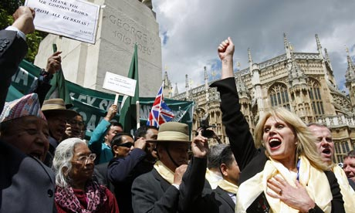
Gurkha Justice Campaign
Joanna Lumley fronted the campaign to help the Gurkha’s fight deportations from the UK
Lumley used her influence to gain lots of media attention
Lumley was invited to have tea with PM Gordon Brown to discuss the issue
Eventually the government made an announcement that all Gurkha’s who had served the British army would be allowed to settle in the UK
This shows that a strong celebrity leader can help your campaign

Slide 26
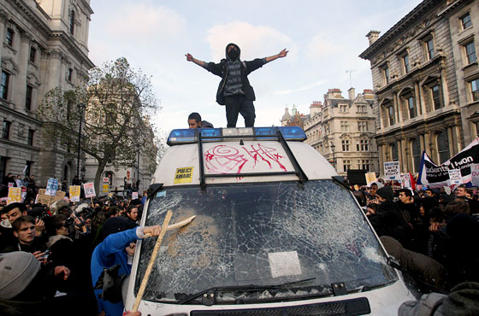
Student Riots
In November 2010 Students took to the streets of London to protest against the Con-Lib proposed tuition fees.
Nick Clegg had promised he would never vote for tuition fees…less than a month into the coalition he had voted for tuition fees
The biggest percent of the protests were peaceful however there were some cases of extreme violence
The Tory headquarters were stormed and students refused to move when riot police came.
Some of the protesters threw large objects from the roof and fought with police officers
Prince Charles and Camellia’s car was attacked
This is an example of a cause group who lost public support because they used extreme methods

Slide 27
Difference between Cause and Sectional Groups
Cause groups are defined by the cause that they represent
Anyone can join. The more members they have the more powerful they tend to be – why?
A person interested in animals may join an Animal Rights group such as PETA
Greenpeace if someone cares about environmental issues.
These groups can vary in size and as mentioned already they can be permanent or temporary depending on their issue
Notes:
27

Slide 28
Sectional Groups
People join these to bring benefits to themselves
Membership is restricted to those who share a similar background as they exist to protect members self interests.
Usually they are work related
Trade unions, employers associations and professional bodies.
Example of a sectional pressure group is the British Medical Association (BMA), who looks after the rights of those involved in the medical profession.
Examples of insider sectional groups include CBI and The Law Society
Sometimes these groups can be outsider for example think about the private sector workers who were protesting against government cuts – teachers were involved

Slide 29
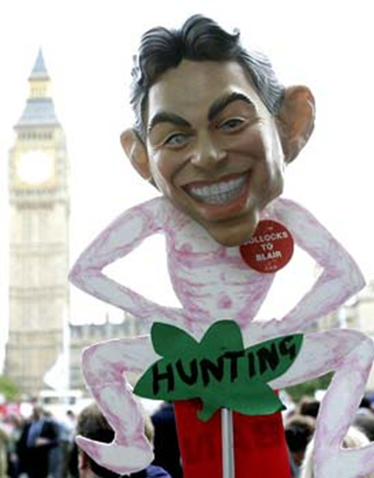
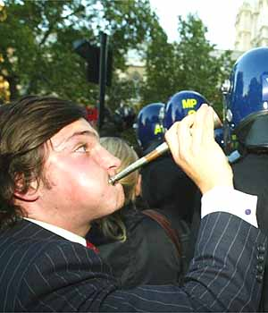
Are Pressure Groups Good or Bad for Democracy?
Good
Allow participation in democratic process
Can raise awareness between elections
Give minority groups a voice
Raise issues of importance
Make decision makers aware
For each of these you would need to illustrate with examples
Notes:
29

Slide 30
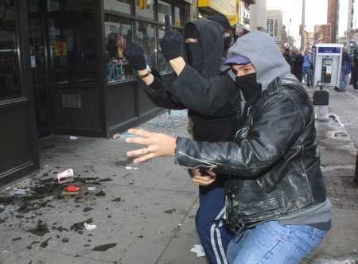
Are Pressure Groups Good or Bad for Democracy?
Bad
Some groups more powerful than others
Money talks
Insider groups have privileged access
Secret deals are bad for democracy
No pressure group represents over 50% of public
Should not hold government to ransom
Should not break the law
Again illustrate with examples

Slide 31
The Influence of the Media
What we will be looking at
The role of the media in the political system
The influence of the media in the political system
Different examples of when the media have held the government to account

Slide 32
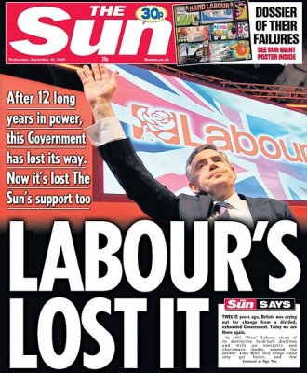
Other Influences on the Political Process – The Media
The media is very significant nowadays
Some say that it is more important than the opposition in influencing the government
All the political parties are obsessed about getting national newspapers on its side
Think about The Sun moving from Labour back to the Tories in the 2010 election
The Scottish Sun backed the SNP instead of Labour in 2011 Scottish election.

Slide 33

Media
The media is made up of newspapers, radio, magazines, TV, the Internet
All are influential, although to different extremes
The media becomes particularly important at election time
Media scrutiny is very important because it helps to make the government accountable
As the opposition (HMO) has a minority of MPs/MSPs, it can be ineffective
The media lets us know about MPs, Ministers or the government itself and whether or not they are doing anything wrong

Slide 34
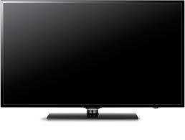
TV
Think about the impact of programmes such as Dispatches, Panorama and News Night which all effectively hold the government to account.
The success of Jamie Oliver at influencing government spending through the programme Jamie’s School Dinners.
The Dispatches programme on care of the disabled has angered the nation or the programme on Jimmy Saville
TV remember is not allowed to be biased however through these programmes they can still effectively impact and change government policy

Slide 35
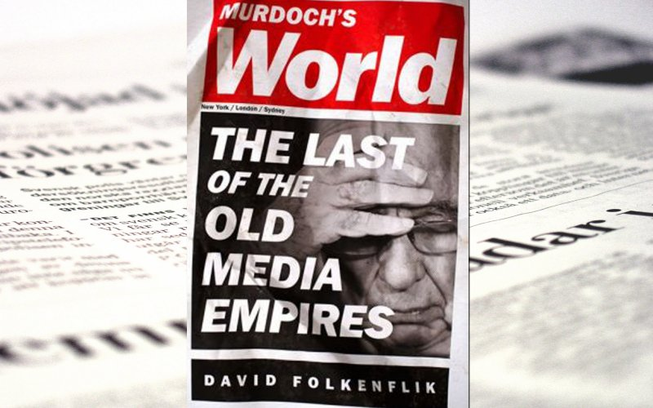
The Press
Newspapers are allowed to be bias and openly support a party. This makes them important to Parties.
The Sun has the highest circulation in UK
News International owned by Rupert Murdoch – very influential person who parties want to please
Although recent events linked to phone hacking have meant many parties want to distant themselves from the Murdoch’s
Newspaper campaigns can be successful – The Daily Record against ‘Loan sharks’.
Scottish Press backed Andrew’s law to get tighter restrictions on airguns in Scotland
The Daily Record supported the campaign against the Bedroom Tax and helped draw attention to the unfairness of this policy

Slide 36
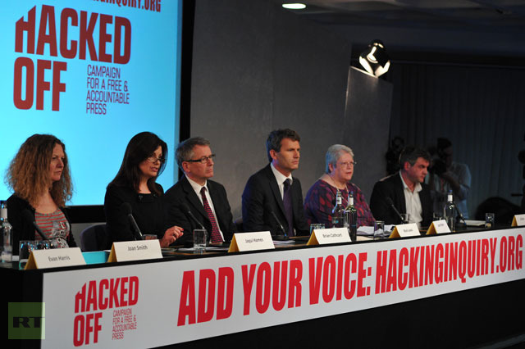
Phone Hacking – “hackgate”
The phone hacking scandal really came to a head in 2011 when evidence occurred that Millie Dowler’s (murder victim) families mobiles had been hacked by journalists
Before this really phone hacking had been confined to celebrities or the Royal family, which although still a clear invasion of privacy had not outraged the public to the same extent – why?
Top editors including David Cameron’s special advisor Andy Coulson and Rebecca Brooks his close friend have been arrested
Closed down News of the World.
Has brought into question the way the news will be monitored.

Slide 37
The Leveson Inquiry
To prove the government were taking phone hacking seriously, David Cameron set up a public Inquiry into the scandal. Lord Leveson was appointed as chairperson.
The Leveson Inquiry heard evidence from numerous celebrities, police, journalists, newspaper editors and politicians
The Inquiry recommended that the press should self-regulate without government interference, however this body should be backed with legislation and a new code of conduct should be enforced
David Cameron was worried about introducing legislation which limits free press as this is undemocratic. Nick Clegg fully supported the full recommendations from the Inquiry – a split in the coalition

Slide 38
The inquiry has been specifically into the press, not into the media more generally.
Broadcasters are regulated by Ofcom, which is backed by law.
Other people publishing on the internet, such as bloggers and tweeters, are not regulated as such, but are covered by laws on issues such as libel and contempt of court.
Some, including MPs and peers, have questioned the wisdom of bringing more regulation to the press and not the wider internet.
Lord Justice Leveson himself referred to material on the internet as "the elephant in the room".
The Free Speech Network, which represents many editors and publishers, is vigorously opposed to any state involvement in press regulation. It says the press exists to scrutinise those in positions of power, and it could not do that if those it was scrutinising had authority over it.
But the Hacked Off campaign, which represents many alleged victims of phone-hacking, says voluntary self-regulation has failed and its said that the Leveson proposals are the way forward.

Slide 39
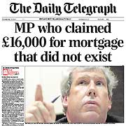
Media scrutiny
The Media do play a hugely important role in ensuring those in power are held to account.
Without journalists investigating the public would often not be aware of what is going on in Parliament
The media broke the story on the expense scandal.
The biggest political scandal in recent years

Slide 40
“The Rotten Parliament”
2005 Parliament
The Daily Telegraph unearthed one of the biggest Political scandals of all time – the MPs abuse of expenses claims.
This disgusted the public and resulted in numerous resignations, deselection and even some arrests.
The ‘John Lewis’ list was the name given to the document that MPs were allowed to claim for.
On top of these items MPs were allowed to claim for a second home if they lived outside London.
Journalists had campaigned for the expenses claims to be made public under the freedom of information, however MPs tried to pass a Bill to prevent this
This failed and the consequences of the release gives a clear indication of why MPs would have wanted to keep these claims private.

Slide 41

MPs EXPENSES
Well done Tony. That is another
Mortgage payment for a house I don’t even live in. I love being a sleazy MP
Some MPs were employing their own family in jobs that did not exist.
MPs were claiming for second homes which were only minutes from their homes or nowhere near Westminster or the mortgage had been already paid off .
In the case of Jacqui Smith (Home Secretary) claiming full mortgage expenses yet she was living in her sisters house.
Some MPs were claiming for houses which they also rented out and gained an income from.
Tony McNulty an MP who had to apologise
to House of Commons because of misuse of expense

Slide 42

Unbelievable claims included
One Conservative MP claiming for the moat of his castle to be cleaned
Plasma TV’s, furniture for second homes, groceries and of course the duck house and pond! (recently just been auctioned)
Jacqui Smith also had claimed for ‘adult videos’ watched by her husband!
Hi me and my husband enjoy all sorts of movies including …

Slide 43
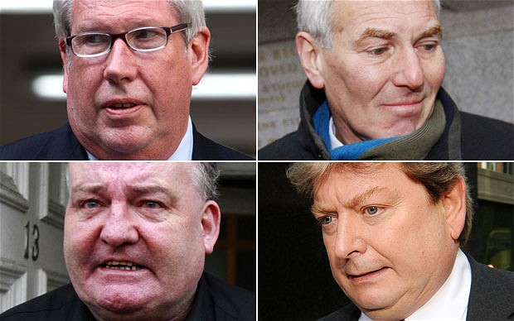
Consequences of the Scandal
Three Labour MPs and a Conservative Peer faced criminal charges for false accounting.
These men tried to claim parliamentary privilege however the cases were heard in criminal courts resulting in jail terms
Michael Martin the Speaker of the HoC was forced to resign after he tried to prevent the scandal breaking and was more angry about the press finding out rather than the abuse of the claims.
Many MPs forced to pay back huge sums of money
Creation of the Independent Parliamentary Standards Authority

Slide 44
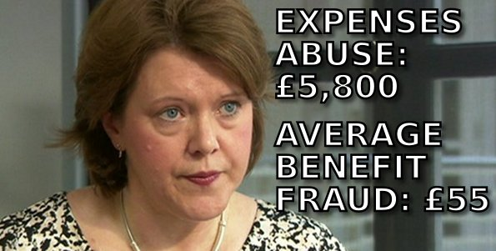
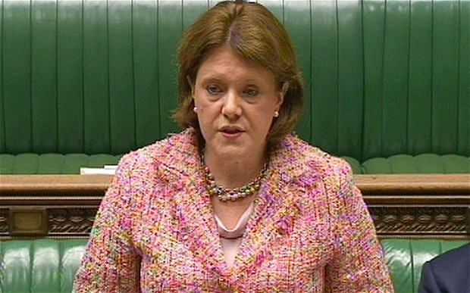
Recent expenses scandal stories
In December 2012, The Daily Telegraph reported that Maria Miller (Minister for culture, sport and media) had claimed over £90,000 in parliamentary expenses for the mortgage and upkeep of a house in south London where her parents lived.
Miller had to pay back some money and make an apology to the House.
This apology last 32 seconds and caused a major media storm
Eventually Maria Miller resigned.
David Cameron was criticised for always backing Maria Miller when she showed little remorse.

Slide 45
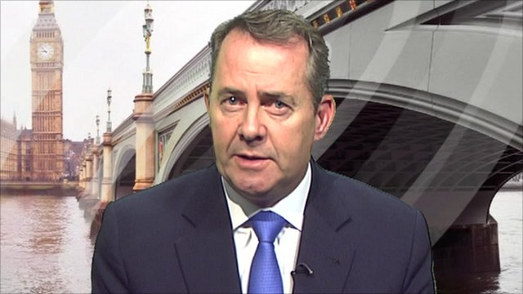
Liam Fox Case
The Times investigation into the affairs of Liam Fox led to him resigning from Government as Defence Secretary
His friend Adam Werrity accompanied him abroad on various occasions at taxpayers expense
Fox could not justify his actions and had to go
This shows the press doing its job
Also, if more such cases occur, it can damage the government and may affect the result of an election

Slide 46
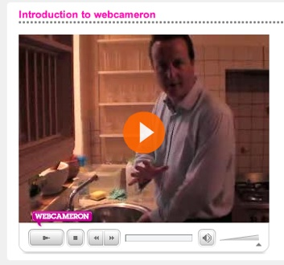
Challenges to Newspaper Influence
Readership of the printed press is falling. If less people buy the newspaper then they are impacting less voters
Loss of public trust due to ‘phone hacking’
Growing importance on Social media – especially among young people
Social media leaves the printed press behind as images, videos etc. get uploaded instantly. Often printed press get their stories from here
All politicians have tried to engage with the digital era by having Twitter accounts and Facebook
David Cameron spend more on this type of media than any other PM – The site, www.webcameron.org.uk, is a key example of this

Slide 47

Why Newspapers are still key
Most people don’t consider a story a story until it is printed
Readership is still relatively high with about 55% of people still reading at least one newspaper a day according to recent polls. This is a big portion of the electorate
Spin doctors are employed by the parties to make their leaders look good

