Slide 1

The Role of Media in the Political System
Lesson Starter
List all the different types of media we have in today’s society.

Slide 2
Today we will…
Understand the impact of the media in the UK.

Slide 3
Success Criteria
Explain how the different forms of media influence decision making in the UK.

Slide 4

The Impact of the Media
Most people in the UK do not attend local or national government decision making meetings so for many people the media is their only source of information on political issues.
The media is also able to influence individual politicians and political parties.
THINK, PAIR, SHARE
What do you think would happen if you took the media out of politics?

Slide 5
Newspapers
Newspapers can choose to support particular parties and can advise its readers to do the same.
Politicians and political parties know that most households in Scotland purchase a daily newspaper.
In turn, they want to get as much positive coverage as possible so that people will support them and vote for them in elections.
It is a very complex relationship between the print media and political parties.
Is it the newspapers that influence the politicians? Or is it the public who influence what the newspapers print?

Slide 6
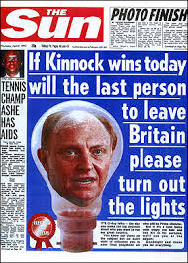
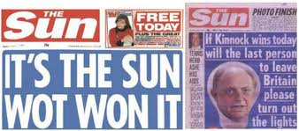
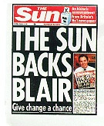
How Powerful is the Tabloid Press?
1997-Labour landslide victory.
1992- Conservative Victory. Neil Kinnock was the Labour Candidate.

Slide 7
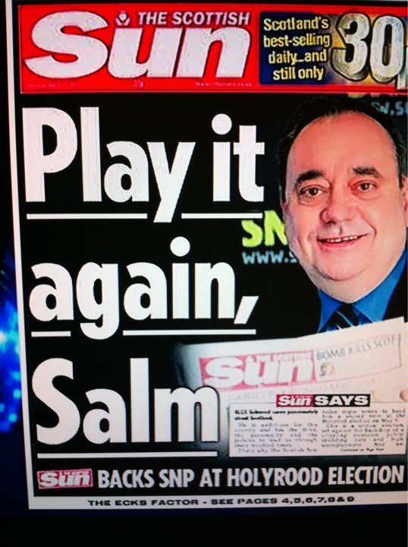
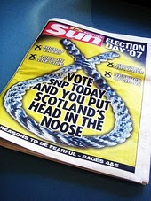
How Powerful is the Tabloid Press?

Slide 8
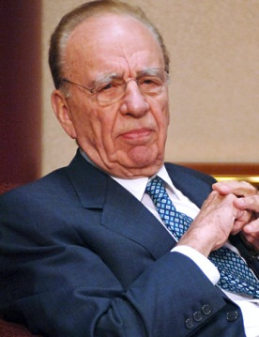
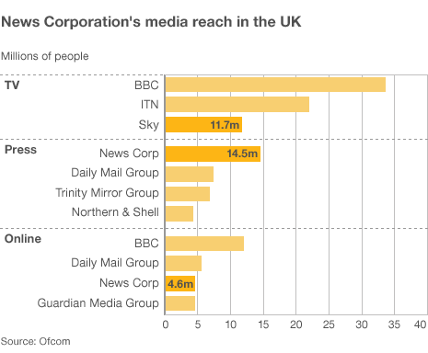
Media Moguls- How influential are they?
Ever since the phone hacking scandal of 2011 and the closure of the News of the World newspaper, the relationship between politicians and the media has came under scrutiny.
Rupert Murdoch owns News Corp and the UK branch of this is News International. In the UK he owns The Sun, The Times, The Sunday Times and The News of the World. They form a huge chunk of the UK newspaper market.
News International reaches 14.5 million per week in the UK- almost double of what other newspaper groups reach in the UK. News International TV and radio services reach another 45 million.

Slide 9
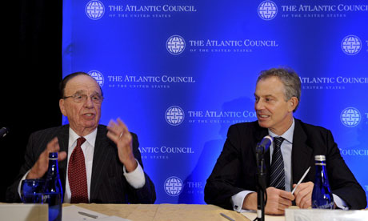
Media Moguls- How influential are they?
Tony Blair and Rupert Murdoch were good friends and many say that Murdoch ‘put him in office’ and between 1997 and 2007 the two men ‘virtually ran Great Britain’.
The Leveson Inquiry has looked into accusations of corruption within Tony Blair’s government and that there was a ‘deal’ in place between the two. It is claimed that in return for The Sun’s backing, Blair would have granted Murdoch certain concessions and that they were getting a good deal out of the Labour government.
In the run up to the Iraq war, it is alleged that Blair made three phone calls to Murdoch. It has been argued that Blair would not have pursued his policy in Iraq if it had not been supported by Murdoch and the Sun.
Overall the Leveson Inquiry has shown that the press and the politicians are far too close. This means that the integrity of political decision making can be called into question.

Slide 10
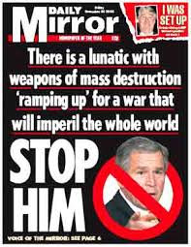
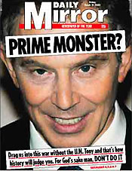
Media Moguls- How influential are they?
Some newspapers were against the decision to go to war in Iraq and the Labour Cabinet of the time completely deny the allegations that they wouldn’t have invaded Iraq if they didn’t have Murdoch’ support.
It could be argued that Tony Blair had more power here and not the media.

Slide 11
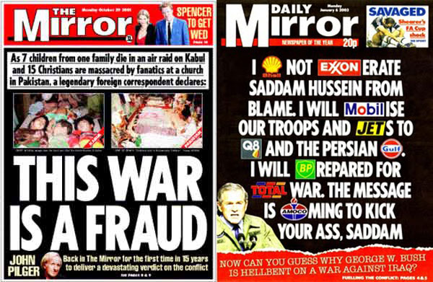

Slide 12
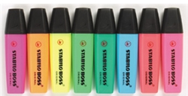
Task
Using the Modernity Scotland hand-out ‘How Powerful is the Tabloid Press’, highlight evidence to show that the media does have an influence over decision making.
Questions
Why was Tony Blair so keen that Labour obtained the support of The Sun?
What did David Clark mean when he said that Tony Blair's real Europe Minister was The Sun's political editor?

Slide 13
Television and Radio
Television is the main source of political information for most voters.
Political parties are aware of this and try to get their politicians seen on the television . Senior politicians will try and get as much coverage.
Also, political parties spend a large amount of money on party political broadcasts.
The Today programme, broadcast on BBC Radio 4 between 6am and 9am everyday and sets the news agenda for the day ahead. Any story that breaks here will dominate the news.
The media has the ability to set the agenda and tone of political coverage. If a big story appears on the breakfast news, then politicians will have to respond to it in interviews during that day. If they fail to do so, then the public will think that they are inadequate and doing nothing.
TV is not allowed to be biased however there have been examples of programmes that have had an impact and changed government policy. For example, the Jamie’ School Dinners and the Dispatches programme on Jimmy Saville.

Slide 14

The Media and Image
It has been said that the media, when it comes to political reporting, is far too obsessed with personalities and conflict rather than focusing on political decision making.
As a result, politicians are far too concerned about their image in the press and will go to great lengths to get positive publicity.
All governments hire spin doctors to communicate the work of the government to the public.
Watch this clip about spin doctors. Think about:
Who has more power: a politician, the media or the spin doctor?

Slide 15
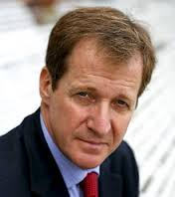
The Role of the Spin Doctor
Alistair Campbell was Tony Blair’s spin doctor.
He changed the role of the spin doctor. He established himself as Blair’s right hand man.
He arguably shifted the balance of power from the media back to the politicians.
Neil Kinnock (previous Labour leader) had been ruined by the press and Tony Blair was very aware that he had to portray a good image to the media- hence he hired Alistair Campbell.
He would only let the press interview politicians when they got permission from him. He also had a tendency to ‘browbeat and cajole journalists, to fight for every comma and exclamation mark in every headline, contest every quote, challenge every piece of analysis’.
Analysis: Labour enjoyed success and positive public opinion as Campbell was able to control what the press reported. Therefore media does not have all the control.
Watch these video clips.
Note down the examples of political spin

Slide 16
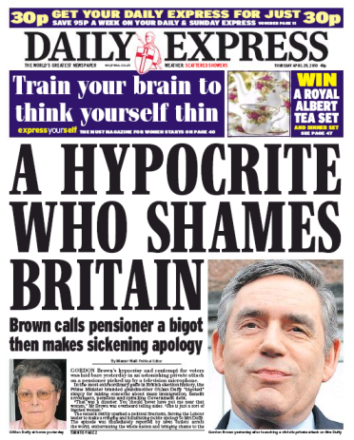
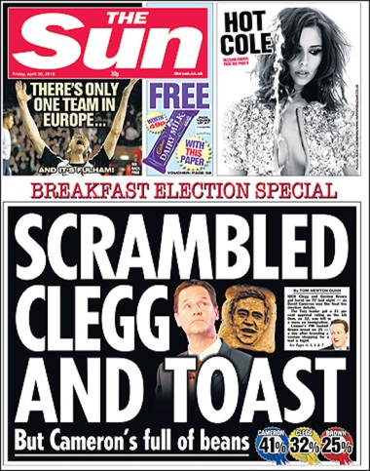
Image and the Media
The media focus on the image of the leader and this can have an impact upon decision making.
It will influence who political parties will put forward as candidates and they may not be the best person for the role.
It could be a case of image over substance. Are leaders chosen because they have a winning smile and appear smart rather than for their policies?
Some believe Tony Blair became Labour leader ahead of Gordon Brown because he appealed to women voters. Tony Blair was seen as the ‘modernising’ force of the Labour party.
Blair's personality - and his ability to connect with people through television – was central to Labour's appeal and that it is why he was the preferred choice.
Gordon Brown was portrayed very negatively in the media and he los the 2010 General Election.

Slide 17
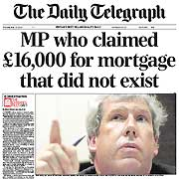
Media scrutiny
The Media do play a hugely important role in ensuring those in power are held to account.
Without journalists investigating the public would often not be aware of what is going on in Parliament
The media broke the story on the expense scandal.
The biggest political scandal in recent years

Slide 18
Holding representatives to account
In a democracy the media have the responsibility to keep a check on the work of the government and hold them to account.
In recent times, some newspapers have uncovered scandals and as a result the work of the government has been impacted.
The Telegraph newspaper uncovered the expenses scandal 5 years ago. David Cameron has recently admitted that the public’s anger over the expenses scandal is still ‘raw’ and needs to be acted on.
In 2010, because of the scandal, the government reformed the expenses system making it more ‘transparent’
The scandal has continued with Maria Miller, Culture Secretary, being accused of breaking the rules by claiming expenses for a second house.
She faced heavy and severe criticism in the press.
Social media such as Twitter highlighted that the public were outraged and that she should resign.
She bowed to pressure from the media and resigned. Cameron also faced severe criticism as he refused to sack her.

Slide 19

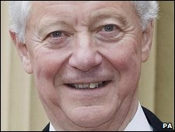
“A Scandal that will not die”
The press uncovered that there were a whole host of MPs who were claiming expenses illegitimately.
Conservative MP Sir Peter Viggers claimed £30,000 for gardening expenses. Including a duck island for his pond!
Lots of MPs are now paying back their expenses.
Three Labour MPs and a Conservative peer went to jail over the scandal.
The Independent Parliamentary Standards Authority has now been set up to monitor the situation.

Slide 20
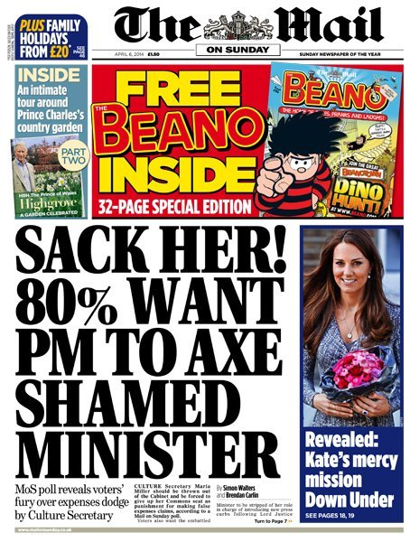
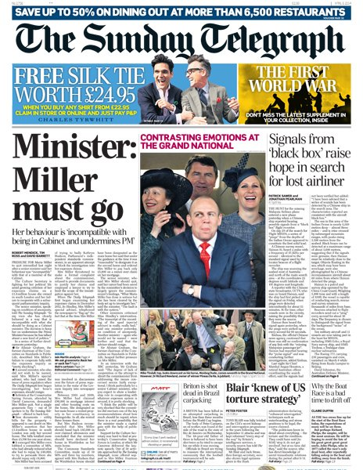
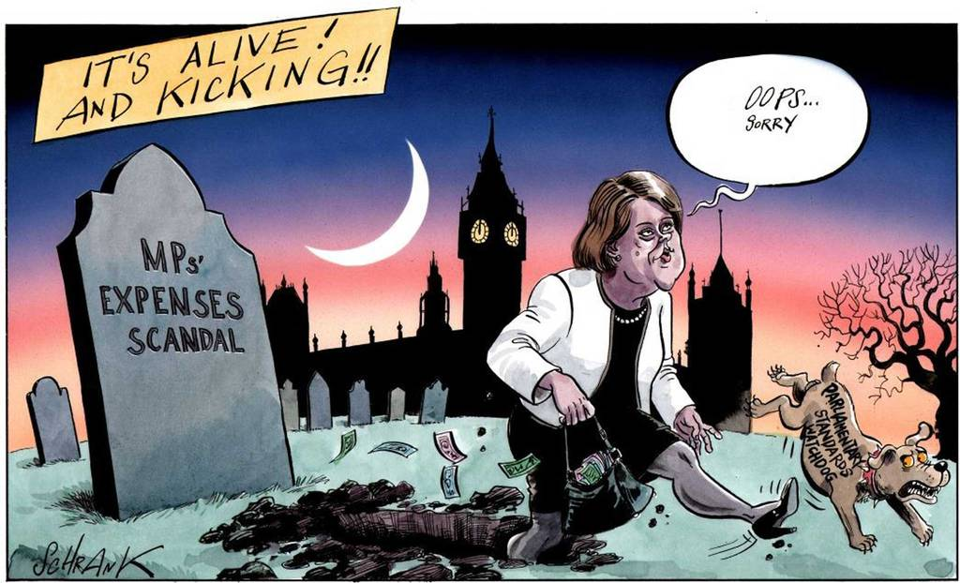

Slide 21


Phone Hacking Scandal
The credibility of the press has really been knocked in recent years due to the hacking scandal-’hackgate’
In 2011 it became public knowledge that journalists had been hacking into mobiles of the Royal Family and a murder victim’s family (Millie Dowler)
Closed down the News of the World and editors such Rebecca Brooks and Andy Coulson have been taken to court.
Leveson Inquiry has been set up to show the public that the Government are trying to do something about the conduct of the press.
The outcome was that press should self-regulate with government interference.

Slide 22
The inquiry has been specifically into the press, not into the media more generally.
Broadcasters are regulated by Ofcom, which is backed by law.
Other people publishing on the internet, such as bloggers and tweeters, are not regulated as such, but are covered by laws on issues such as libel and contempt of court.
Some, including MPs and peers, have questioned the wisdom of bringing more regulation to the press and not the wider internet.
Lord Justice Leveson himself referred to material on the internet as "the elephant in the room".
The Free Speech Network, which represents many editors and publishers, is vigorously opposed to any state involvement in press regulation. It says the press exists to scrutinise those in positions of power, and it could not do that if those it was scrutinising had authority over it.
But the Hacked Off campaign, which represents many alleged victims of phone-hacking, says voluntary self-regulation has failed and its said that the Leveson proposals are the way forward.

Slide 23
How influential is the Media? Analysis
Readership of the printed press is falling. If less people buy the newspaper then they are impacting less voters
Loss of public trust due to ‘phone hacking’
Growing importance on Social media – especially among young people
Social media leaves the printed press behind as images, videos etc. get uploaded instantly. Often printed press get their stories from here
All politicians have tried to engage with the digital era by having Twitter accounts and Facebook
David Cameron spend more on this type of media than any other PM – The site, www.webcameron.org.uk, is a key example of this
However, many still read newspapers and something is not considered a story until it is printed.

Slide 24
Exam Task
Analyse the effect the media has on decision making – 12 marks
Unelected bodies can influence decision making in parliament. Discuss – 20 marks

Slide 25

Was I successful?
Explain how the different forms of media influence decision making in the UK.

