Slide 1


Lesson Starter

Slide 2
What will I learn?
To describe the international influence the USA has
To examine US foreign policy
To identify examples of US intervention around the world
Notes:
2

Slide 3
Success Criteria
Describe the international influence the USA has
Examine US foreign policy
Identify examples of US intervention around the world

Slide 4
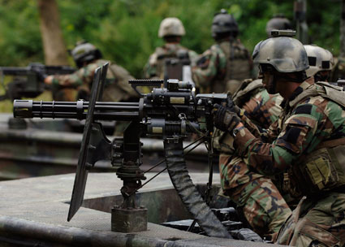
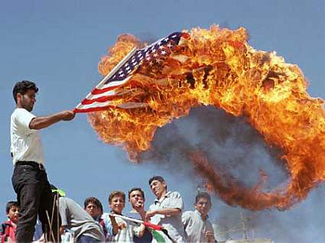
The USA
Does it want to be the world’s policeman?

Slide 5
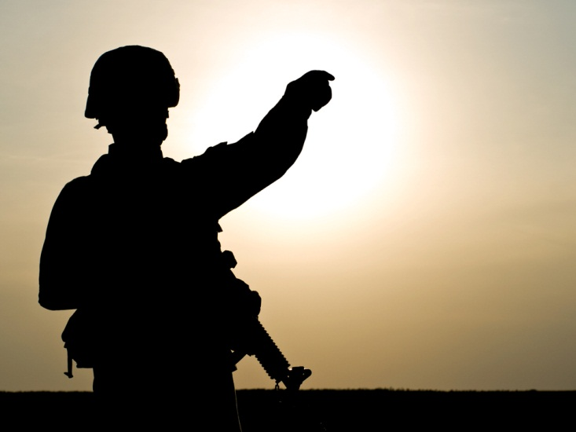
This presentation looks at
President Obama’s foreign policy
Examples of US intervention around the world

Slide 6
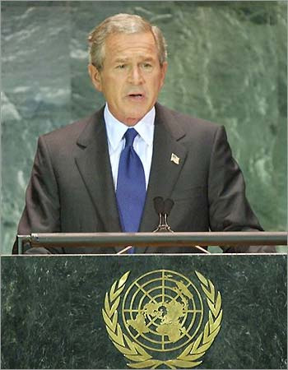
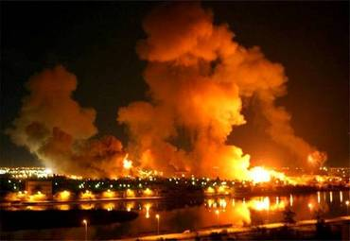
9/11 and After: The Bush Doctrine: Retaliate First
In the aftermath of 9/11, President Bush declared that there would be a “war on terror”.
Not only this, but that the US would take “pre-emptive action” to prevent America being attacked.
Hence, first the US and NATO moved into Afghanistan to tackle the Taliban.
Then, in March 2003, “shock and awe” as the US attacked Iraq.
Notes:
Using superior technology, America's army, along with NATO, helped local Afghans overthrow the Taliban in 2001. The US achieved a quick conventional victory in Iraq in 2003. Or it thought it had.

Slide 7
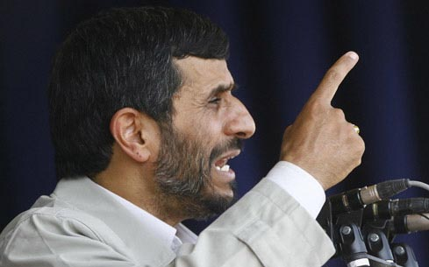
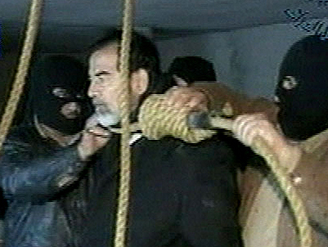
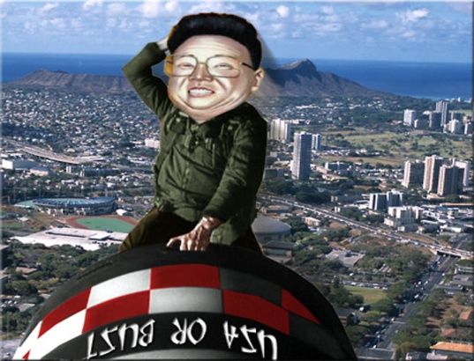
The Axis of Evil
President Bush identified an “axis of evil”; certain states he believed were the US’s enemies; Iraq, Iran and North Korea.
President Obama has since dropped the use of the term “war on terror” as he believes that it unites the USA’s enemies.
Notes:
The term Axis of Evil was used by George Bush in his 2002 State of the Union Address to describe governments that he accused of sponsoring terrorism and seeking weapons of mass destruction.
Bush named Iraq, Iran, and North Korea in his speech. The full speech is below;
[Our goal] is to prevent regimes that sponsor terror from threatening America or our friends and allies with weapons of mass destruction. Some of these regimes have been pretty quiet since September the 11th. But we know their true nature. North Korea is a regime arming with missiles and weapons of mass destruction, while starving its citizens.
Iran aggressively pursues these weapons and exports terror, while an unelected few repress the Iranian people's hope for freedom.
Iraq continues to flaunt its hostility toward America and to support terror. The Iraqi regime has plotted to develop anthrax, and nerve gas, and nuclear weapons for over a decade. This is a regime that has already used poison gas to murder thousands of its own citizens—leaving the bodies of mothers huddled over their dead children. This is a regime that agreed to international inspections—then kicked out the inspectors. This is a regime that has something to hide from the civilized world.
States like these, and their terrorist allies, constitute an axis of evil, arming to threaten the peace of the world. By seeking weapons of mass destruction, these regimes pose a grave and growing danger. They could provide these arms to terrorists, giving them the means to match their hatred. They could attack our allies or attempt to blackmail the United States. In any of these cases, the price of indifference would be catastrophic. Bush's doctrine of “pre-emption” refers to America’s policy of “retaliating first” against alleged rogue states.
Iran’s leader Mahmoud Ahmadinejad has had strained relations with the US. He has been accused of anti-semitism, even of being involved in the 1979-81 hostages crisis. However, it is the US’s suspicion that Iran is planning a nuclear weapon capability that is alarming the US more.

Slide 8
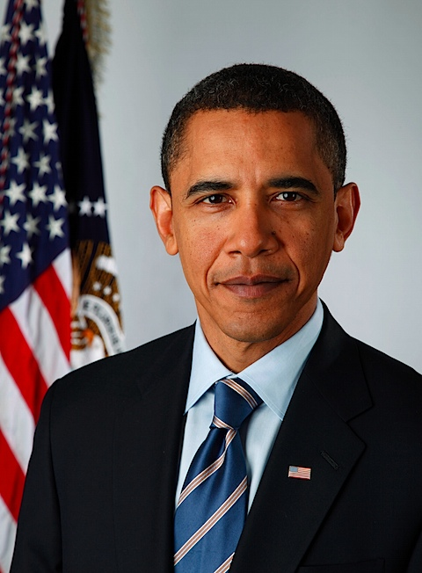
2008 The Obama Doctrine?
Before becoming President, in June 2008, Obama outlined what would be his foreign policy objectives:
end the war in Iraq responsibly
finish the fight against al Qaeda and the Taliban
secure all nuclear weapons and materials from terrorists and rogue states
achieve true energy security
rebuild alliances to meet the challenges of the 21st century
President Obama ended the Bush presidency’s talk of a “war on terror”.
Obama claimed that the US would intervene around the world for “humanitarian” reasons as well as economic interests.
President Obama may well pursue “humanitarian interventions” around the world.
But the US expects a President to protect the country’s economic interests abroad. “National security” and economic interests are closely connected.
The Obama Doctrine

Slide 9
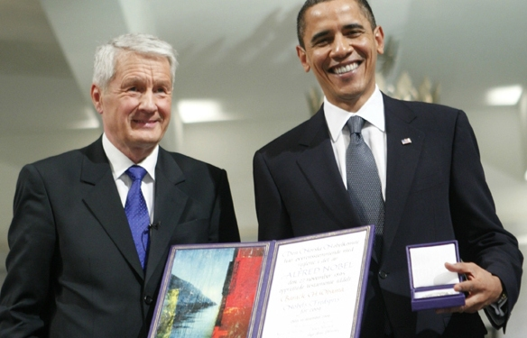
The 2009 Nobel Peace Award
The Nobel prize is awarded to the person who...”shall have done the most or the best work for fraternity between nations, for the abolition or reduction of standing armies and for the holding and promotion of peace congresses”.
Obama was awarded the prize after only a few weeks in post! This was more for his promises of peace, rather than for anything delivered.
Obama promised to close the American detention facility at Guantanamo Bay, move towards a nuclear free world and bring to an end the conflicts in Iraq and Afghanistan.
Not all of these promises have been kept and in retrospect the Nobel Award seemed, at best, to be premature.
President Obama awarded 2009 Peace prize

Slide 10
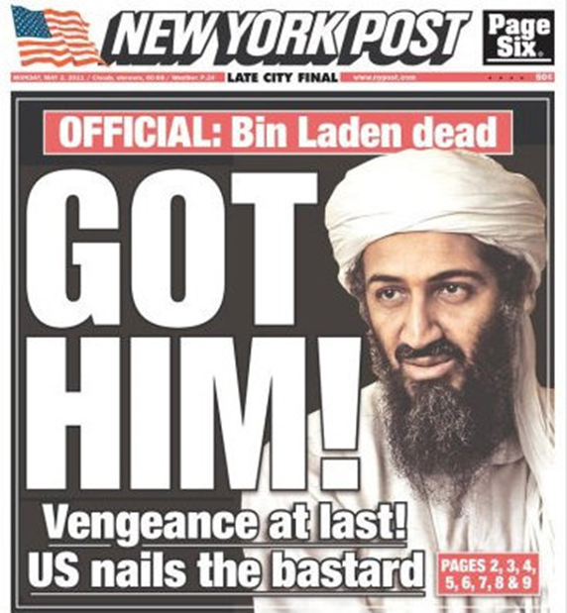
A War President?
Despite a change in tone from the Bush presidency, Obama has, arguably, been one of the most aggressive Presidents of recent times.
President helped overthrow Colonel Qadaffi in Libya.
He has ordered more than 250 drone attacks in Pakistan.
He has authorized a threefold increase in the number of American troops in Afghanistan.
He became the first president to authorize the assassination of a United States citizen, Anwar al-Awlaki, (who was born in New Mexico and played an operational role in Al Qaeda, and was killed in an American drone strike in Yemen).
President Obama ordered and oversaw the Navy SEAL raid that killed Osama bin Laden.
Bin Laden Dead

Slide 11
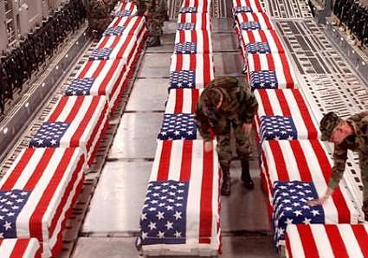

Iraq
On June 29, 2009, U.S. troops formally withdrew from Baghdad and other Iraqi cities, in accordance with former U.S. President George W. Bush's security pact with Iraq known as the Status of Forces Agreement. U.S. troops left Iraq on Dec. 31, 2011.
The operation has cost Washington nearly $1 trillion (£643bn).
The war in Iraq succeeded in overthrowing, and executing, former President Saddam Hussein. But no weapons of mass destruction were ever found.
An estimated 4,000 US troops were killed and anything between 100,000 – 600,000 Iraqi civilians.
Iraq now has it’s own democratically elected Government.
But, is the US, and the UK for that matter, still seen as the great enemy by Muslims in the middle east?
Withdrawal

Slide 12
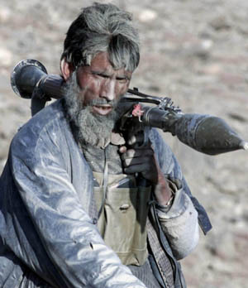
Afghanistan
In June 2010, the Afghanistan conflict surpassed Vietnam as the longest war in US history. More than 2,000 US troops have been killed and more than 17,000 have been injured. The war is costing the US around $2 billion per week.
American forces in Afghanistan have fallen to 68,000, from a peak of 100,000 in mid-2011. President Obama, has promised that a “steady pace” of withdrawal will continue until, by the end of 2014, only about 20,000 trainers and special forces personnel will be left.
The US publicly states that the Taliban have been beaten back and that afghan forces will be able to hold the ground once US forces leave. Others are not so sure. They believe that America, like so many other countries before, has given up on Afghanistan and is looking for a dignified way out.
International troops withdraw

Slide 13
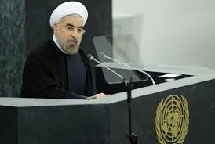

Iran
New Iranian President Hassan Rouhani
(educated at Glasgow Caledonian University) has sought to improve US/Iran relations. He has opened negotiations with Obama on Iran’s nuclear development programme which the US has always believed involved developing nuclear weaponry rather than just energy.
The UN Security Council big 5, plus Germany, has asked Iran to halt production and stockpiling of uranium enriched to 20% - a step away from achieving a nuclear weapons capability. Iran has agreed.
President Hassan Rouhani at UN

Slide 14
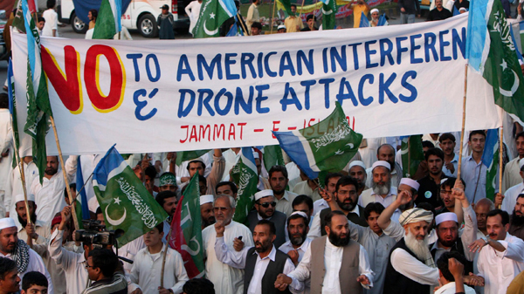
Pakistan
In the campaign against Al-Qaeda, CIA-controlled Predators and Reapers have been bombing tribal areas since June 2004. Pakistan now opposes these strikes and maintains that the drone attacks are against international law. The US claims that the drone attacks are legitimate acts of self defence against Al-Qaeda.
No-one questions that there have been civilian casualties of these unmanned killing machines. Pakistan claims the figures are into the hundreds, the US claims much less.
Obama defends drone attacks

Slide 15
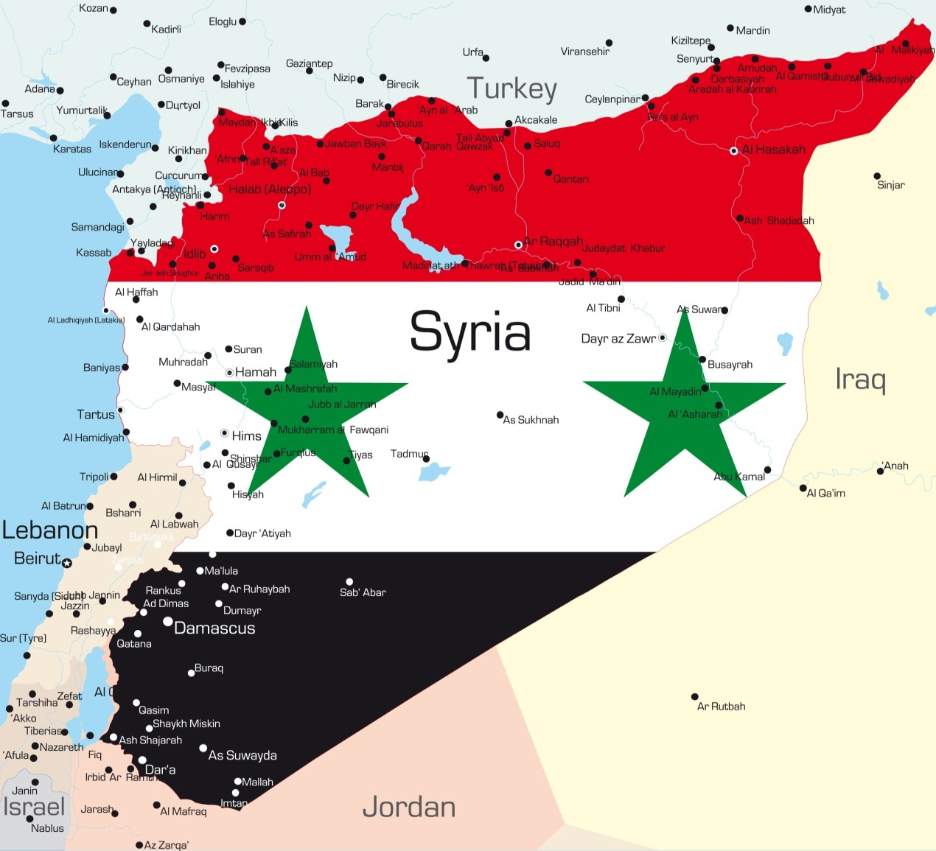

Syria
The US, like the UK, opposes the regime of Bashar al-Assad and supports the rebel fighters, The Free Syrian Army.
The US, like the UK, has not directly sent arms to the but has provided some $25 million in non-lethal aid to the rebels, funding such things as communications equipment.
It has also committed $76 million in humanitarian aid.
Obama was keen to militarily strike Syria in August 2013 as a result of Assad’s alleged use of chemical weapons. But opposition in the UK (Prime Minister David Cameron lost a House of Commons vote) and a Russian compromise forced Obama to back off.
Obama and Syria

Slide 16
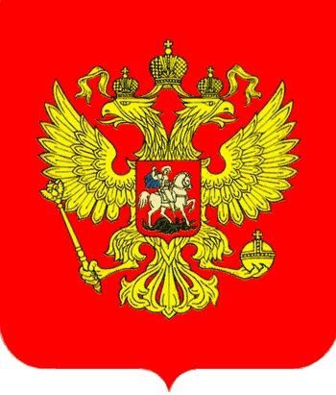
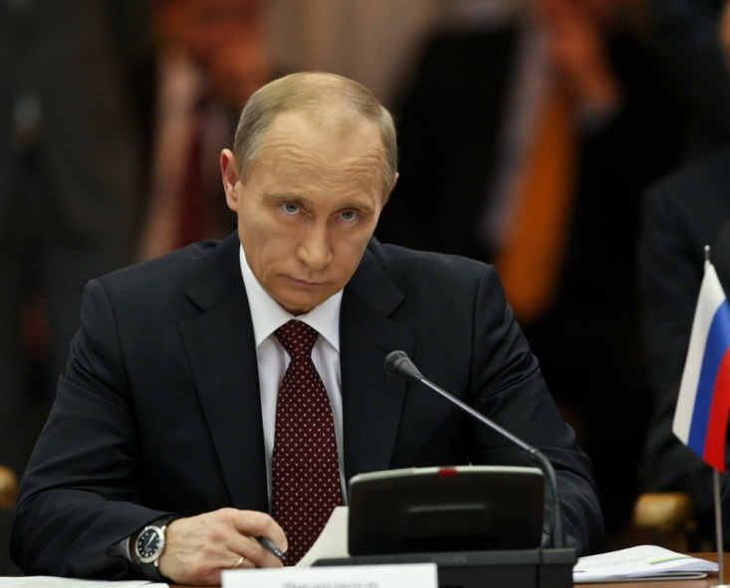
Russia
Russia signed the New Start arms limitation treaty with President Obama in April 2010, signalling a more harmonious relationship between Washington and Moscow.
But, Russia remains concerned about NATO plans to build a new missile defence system in Romania.
There have been comments within Russia that it may withdraw from New Start treaty, possibly even moving its missile forces closer to NATO borders should NATO press ahead with its defence system.
Relations between the US and Russia, as shown by Russia’s UN support for President Assad in Syria, remain lukewarm.
Putin letter to New York Times, 2013
Notes:
US/Russia relations which were so good after 9/11 have taken a turn for the worse. Russia is now richer, thanks to its gas and oil reserves. Putin is very concerned at the US’s planned missile shield, which it would like to site in Poland and the Czech republic. The US claims it is to protect the US from a potential nuclear strike from Iran. But Russia is suspicious and sees this shield as “encirclement”.
Putin responded by threatening the US with the re-targeting of Russia’s nuclear missiles on Europe. He has subsequently calmed down and met George Bush in June 2007 for more amicable talks.
In May 2008 Russia's president Dmitry Medvedev called for a new peace treaty in Europe to resolve the growing differences between Moscow and the West.
Medvedev said military expansion led by America and Nato "worried" Moscow and could destroy relations between East and West "in a radical way, for a long time".

Slide 17
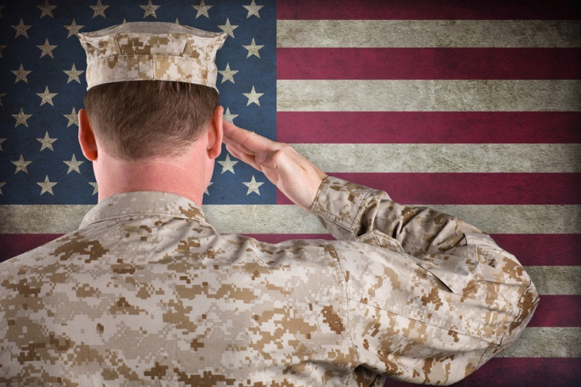
Asia-pacific
The Asia-Pacific region is now a "top priority" of US security policy.
The US plans to station a full US Marine task force in Australia by 2016.
The measure will eventually see 2,500 US personnel based in the north of the country.
The move is undoubtedly to challenge China, which is striving to be the main power in the region.
"With most of the world's nuclear powers and some half of humanity, Asia will largely define whether the century ahead will be marked by conflict or co-operation, needless suffering or human progress”
President Obama
US Troops to Australia

Slide 18
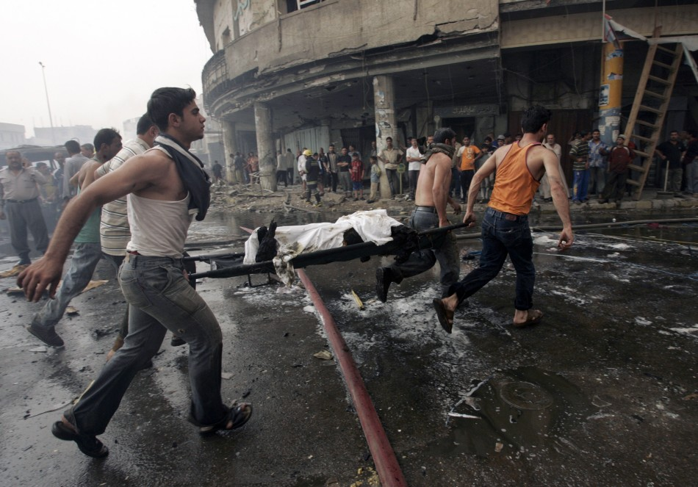
Al-Qaeda: Down but not out
Al-Qaeda has been severely weakened by the US.
Bin Laden is dead and so are many of its other leaders.
But the organisation itself is not dead. It is now a looser network of subsidiaries, but still has individuals and organisations capable of lethal attacks.
The constant menace of a bomb attack on a plane or suicide attack on a café will be with us for some time.
Al-Qaeda still at large

Slide 19
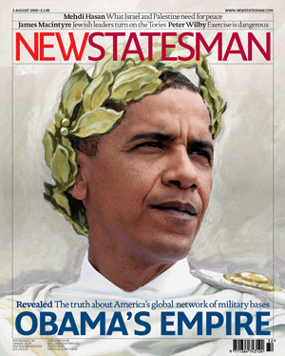
Still number one?
“For globalism to work, America can’t be afraid to act like the almighty superpower that it is.…
The hidden hand of the market will never work without a hidden fist—McDonald’s cannot flourish without McDonnell Douglas, the designer of the F-15.
And the hidden fist that keeps the world safe for Silicon Valley’s technologies is called the United States Army, Air Force, Navy and Marine Corps”.
Thomas Friedman, What the World Needs Now,
New York Times, March 28, 1999

Slide 20
Success Criteria
Describe the international influence the USA has
Examine US foreign policy
Identify examples of US intervention around the world

