Slide 1
Background information
The United States of America

Slide 2
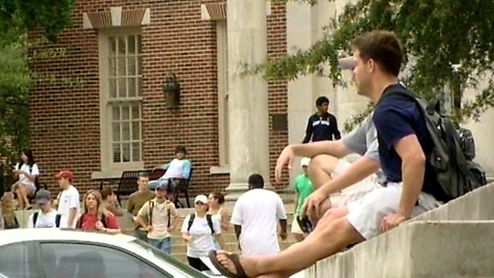
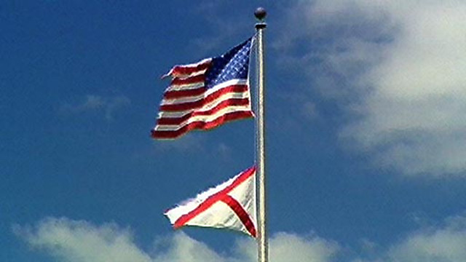
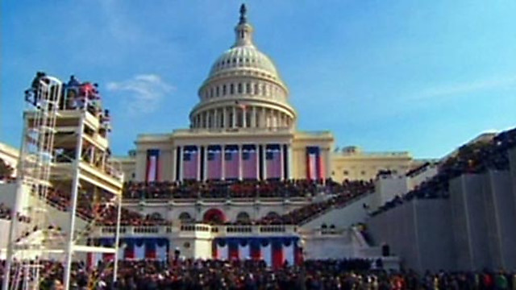
An illustration of the USA, racial and class discrimination.
Why ethnic minorities in the USA are under-represented in political bodies.
The impact of education on poverty and crime in the USA.
What advantages draw immigrants to the USA and what barriers do they face getting there?
An illustration of ethnic minorities and social class in the USA.
A definition of the American Dream.
Noah, a teenager from America, describes the US political system.
The USA's capitalist economy brings benefits for some but leaves others disadvantaged.

Slide 3
What do I need to know ;
Political issues:
Type of government
Main institutions of government
Participation:
Rights and responsibilities of individuals within the USA
opportunities for (and limits to) participation in the political system, the representation of citizens in the political system.
-This section must cover the extent to which the USA could be considered to be democratic.
Socio/economic issues:
Population issues (overpopulation, internal migration, immigration and distribution)
Employment
Wealth inequalities
Health
Education
Housing
Crime and law
-This section must cover Government reactions and responses to Socio/economic issues
The impact of the world power on other countries.

Slide 4
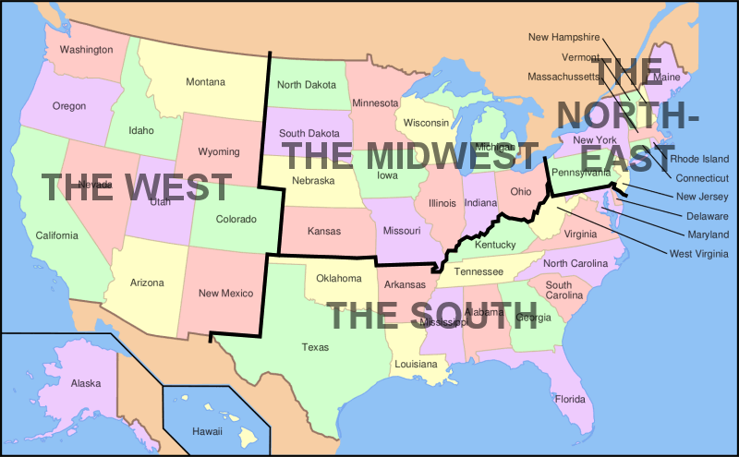
International Issues
United States of America
Background information

Slide 5
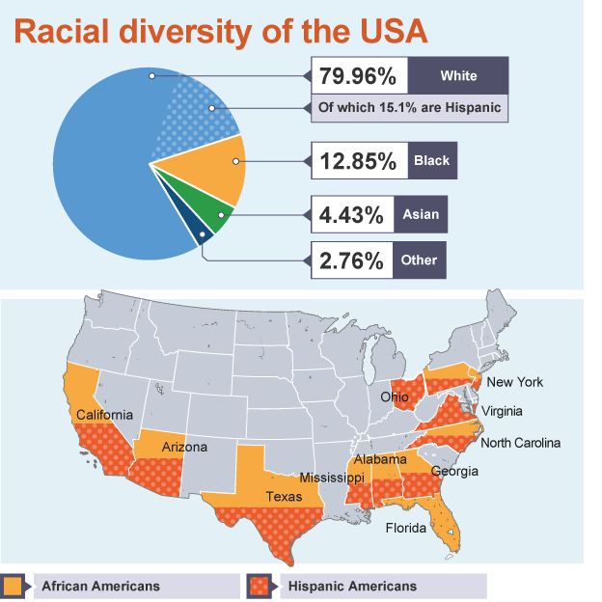
International Issues
United States of America
Background information
Race in the USA - Demography
Hispanics are the second largest ethnic group in the USA and are concentrated in the states which are in proximity to the border with Mexico including California, New Mexico, Arizona, Texas, Mississippi and Alabama.
According to the US Census, the nation's Hispanic population grew from 35.3 million in 2000 to 50.5 million in 2010. This is a 43% increase. In addition, there are an estimated 11 million unauthorised illegal Hispanic immigrants according to the Department of Homeland Security.

Slide 6
International Issues
United States of America
Background information
Race in the USA - Demography
In 2013, the US population was estimated to be around 316 million. In terms of ethnicity, the population make up is as follows:
79.96% white (including 15.1% Hispanic)
12.85% African American/ Black
4.43% Asian American
0.97% Amerindian and Alaska
0.18% native Hawaiian and other Pacific islander
1.61% has two or more races

Slide 7
International Issues
United States of America
Background information
Race in the USA - Demography
In terms of languages spoken, it is estimated as follows:
82.1% of Americans speak English as their first language
Spanish 10.7%
other Indo-European 3.8%
Asian and Pacific island 2.7%
other 0.7%

Slide 8
International Issues
United States of America
Background information
Race in the USA - Demography
The African American population exceeds 500,000 in 15 states.
African Americans are the largest minority group in 24 states, compared with 20 states in which Hispanics are the largest minority group. Washington DC has most African Americans (51%), followed by Mississippi (37%).
More than half (54%) of the African American population live in the South.

Slide 9
International Issues
United States of America
Background information
Race in the USA - Demography
African Americans
Economically, African Americans have benefited from the advances made during the Civil Rights era of the 1950s and 60s.
The racial disparity in poverty rates has narrowed. The black middle class grew substantially in 2000 and 47% of African Americans owned their homes.

Slide 10
International Issues
United States of America
Background information
Race in the USA - Demography
African Americans
In 2001, over half of African American households of married couples earned $50,000 or more. Three years later in 2004, African American workers had the second-highest median earnings of American minority groups after Asian Americans.
In 2010, about 1.1 million African Americans earned over $100,000 a year.
The affirmative action programmes which help African Americans attend university and/or get jobs has also had an impact.

Slide 11
International Issues
United States of America
Background information
Race in the USA - Demography
Hispanic population
According to the 2010 US census, 22% of Hispanic people are living in poverty, nearly double the national average of 12.6%. Many Hispanic people living in America are well off, especially those of Cuban origin in states such as Florida. However, the plight of illegal Hispanic immigrants living in poverty is a subject of concern.

Slide 12
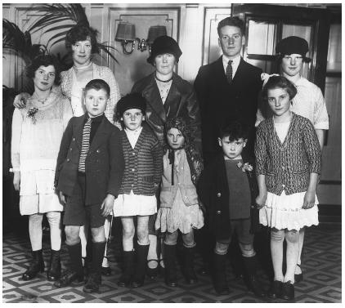
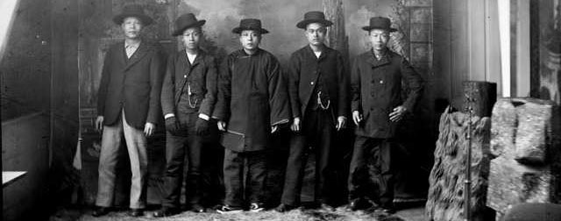
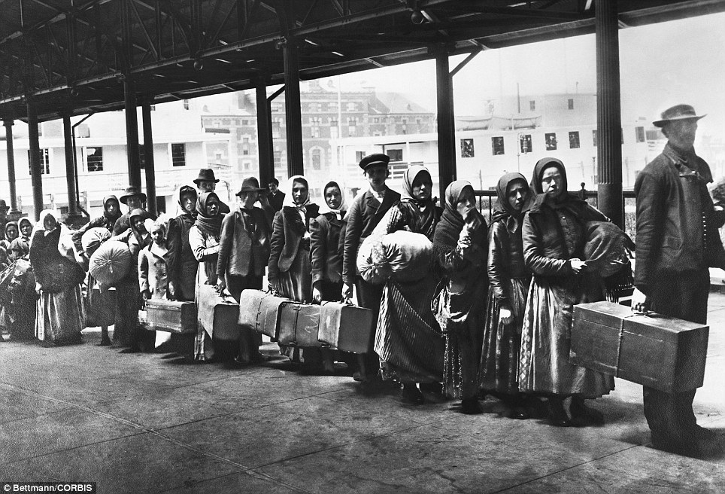
W Why do people move to America?
What groups have you learned about
that have moved to America?
Draw arrows on your map showing the
migration of certain groups.
Use a key to identify each group hy do people move to America?
What groups have you learned about
that have moved to America?
Draw arrows on your map showing the
migration of certain groups.
Use a key to identify each group.

Slide 13
International Issues
United States of America
Background information

Slide 14
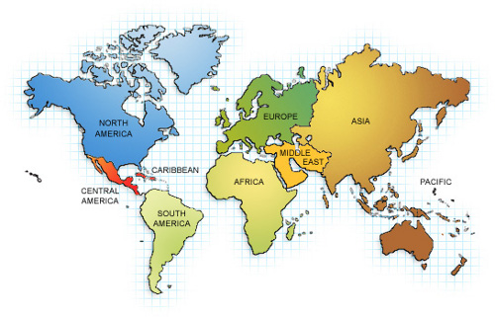
In the 19th Century the Irish immigrated to America
to escape famine and find work.
1

Slide 15
Historically, African’s were forced over to America as
part of the slave trade. More recently many Africans
move to America to escape poverty and chase opportunity.
4

Slide 16
Chinese people leave China for the US in the hope of
better education, more opportunities and equal rights
for all.
3

Slide 17
Historically, African’s were forced over to America as
part of the slave trade. More recently many Africans
move to America to escape poverty and chase opportunity.
4

